Slide 1


Social Economic Burden and Health-related Quality of Life in Patients with Rare Diseases in Europe (BURQOL-RD) A/101205
www.burqol-rd.com

Slide 2


Background
www.burqol-rd.com
“Council Recommendation on a European action in the field of rare diseases”
2009/C 151/02
Need of tools to measure the initial status and the impact of the national policies based on the recommendations of EUROPLAN
EUROPLAN (2008 – 2011)
To develop recommendations to elaborate national plans for RD, to facilitate the coherence of national initiatives with best practices.
(2010 – 2013)
BURQOL-RD
Notes:
The “Council Recommendation on a European action in the field of rare diseases” allows common policy guidelines to be shared everywhere in Europe. The supporting tools prepared by EUROPLAN to promote and develop National Plans or Strategies for RDs and the spreading of relevant cases in the field of rare diseases within EU MSs will link national efforts with a common strategy at European level. This “double-level” approach ensures that progress is globally coherent and follows common orientations throughout Europe.

Slide 3
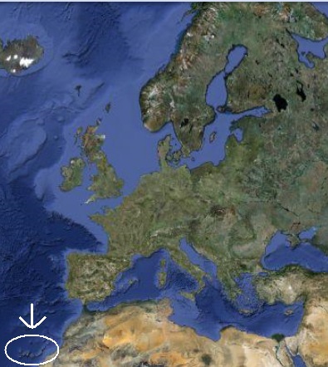
BURQOL-RD Project
www.burqol-rd.com
BURQOL-RD is a 3 year project under the 2nd Programme of Community Action in the Field of Public Health, that commenced in April 2010.
Funded by the Executive Agency for Health and Consumers (EAHC)
Project Coordinator: Prof. Julio López Bastida
Project Manager: Renata Linertová
Coordinator: Fundación Canaria de Investigación y Salud (FUNCIS), Canary Islands, Spain.

Slide 4
Main Aim: Model
www.burqol-rd.com
BURQOL-RD aims to generate a model to quantify the socio-economic burden and HRQOL of both RD patients and caregivers.
The model will be generated in 10 RD in 8 different European countries.
This model will be adaptable and sufficiently sensitive to capture the differences in the distinct Health and Social Care Systems in the EU Member States.

Slide 5
Specific objectives
www.burqol-rd.com
To generate a framework to measure the socio-economic burden and the HRQOL of RD.
To develop unified instruments to gather information on the socio-economic burden and HRQOL of RD throughout Europe.
To perform a pilot study measuring the socio-economic burden and HRQOL for selected RD.
To refine and package the tools for the continued study of the costs and HRQOL of RD.
The collaboration of National Patient Associations and Federations for the specific RD is fundamental to ensure that all the objectives proposed are successfully reached.

Slide 6











Associated Partners
www.burqol-rd.com
Instituto Superior di Sanita (Italy)
London School of Economics and Political Science (UK)
Leibniz University Hannover (Germany)
Federación Española de Enfermedades Raras (Spain)
The Swedish Institute for Health Economics (Sweden)
University Paris val de marne (France)
Centre for Public Affairs Studies Foundation (Hungary)
Instituto de Salud Carlos III (Spain)
Universita Commerciale “Luigi Bocconi” (Italy)
Mario Negri Institute for Pharmacological Research (Italy)
Bulgarian Association for Promotion of Education and Science (Bulgaria)
Associated Partners are responsible for carrying out all the core activities of the project.

Slide 7







Collaborating Partners
www.burqol-rd.com
National Alliance of people with rare diseases (NAPRD, Bulgaria)
Consulta Nazionale delle Malattie Rare (Italy)
Federazione Italiana Malattie Rare (UNIAMO, Italy)
Allianz Chronischer Seltener ErKrankungen (ACHSE, Germany)
Rare Diseases Sweden (SÄLLSYNTA DIAGNOSER, Sweden)
Hungarian Federation of People with Rare and Congenital Diseases-Rare Diseases Hungary (HUFERDIS, Hungary)
Rare Diseases UK-Genetic Interest Group (GIC, United Kingdom)
Alliance Maladies Rares (France)
Collaborating Partners contribute to specific activities in the project and provide advice and assistance to ensure that all the objectives proposed are successfully reached.

Slide 8
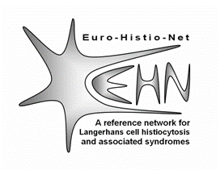


Collaborating Partners
www.burqol-rd.com
Euro-Histio-Net
CRE Enfermedades Raras (CREER) Burgos, Spain
We are especially grateful to EURORDIS for their collaboration and assistance that they provide in certain areas fundamental for the development of the project.
Collaborating Partners contribute to specific activities in the project and provide advice and assistance to ensure that all the objectives proposed are successfully reached.
Notes:
Euro-Histio-Net - An international reference network for Langerhans cell histiocytosis and associated syndromes

Slide 9
Development
www.burqol-rd.com
Selection of 10 RD
to be targeted:
Delphi panel
Patients and caregivers
oriented survey
Model of socio-economic burden
Notes:
We are now at the beginning of the survey.

Slide 10
Target RD
www.burqol-rd.com
Combining the Delphi prioritization of RD and the Carroll diagram →
Final set of RD to be targeted in the study:
Cystic fibrosis
Prader-Willi Syndrome
Haemophilia
Duchenne Muscular Dystrophy
Epidermolysis Bullosa
Fragile X Syndrome
Scleroderma
Mucopolysaccharidosis
Juvenile idiopathic arthritis
Histiocytosis

Slide 11
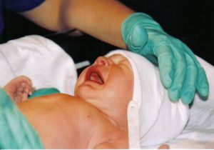
Survey: Patients
www.burqol-rd.com
Patients:
Burden of disease (socioeconomic costs)
E.g. drugs, medical tests, transport, hospitalization, etc.
Health related quality of life
EQ-5D for adults
EQ-5D-Y for children between 6 and 17
Disability
Barthel Index
Demographic data

Slide 12
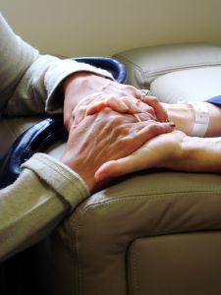
Survey: Caregivers
www.burqol-rd.com
Caregivers
Health related quality of life
EQ-5D
Over-burden of the caregiver
Zarit Scale
Time utilization
Demographic data

Slide 13
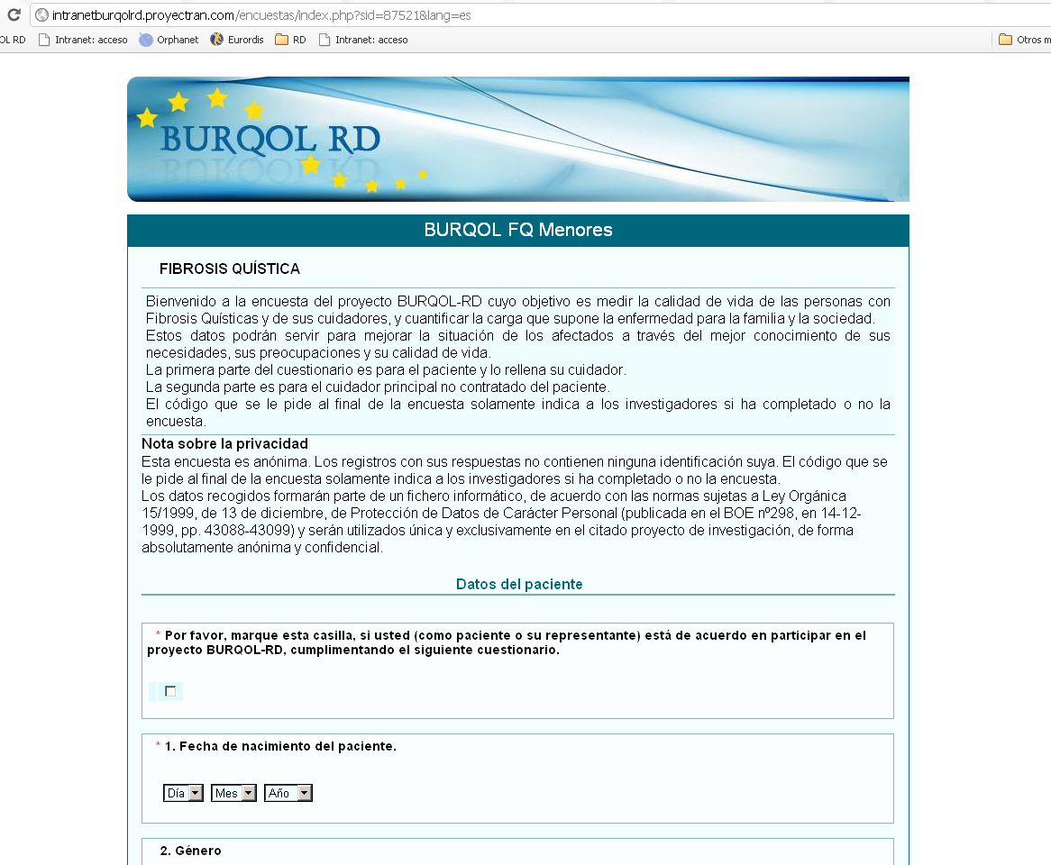
On-line questionnaire
www.burqol-rd.com

Slide 14

On-line survey in Spain
www.burqol-rd.com
Launched in May 2011
First pilot study with patients with Cystic Fibrosis
Contact through the patients’ organizations
Anonymous

Slide 15








Survey in Europe
www.burqol-rd.com
Expected to be launched in Autumn 2011 in:
France
UK
Italy
Sweden
Germany
Hungary
Bulgaria
The collaboration of national patients’ association and federations is fundamental to ensure that all the objectives are successfully reached.

Slide 16
Expected outcomes
www.burqol-rd.com
An integrated and harmonized set of instruments to assess and monitor socio-economic burden and HRQOL of patients affected by RD and their caregivers.
A detailed analysis of the services (health and social care) received by people with specific RD in different EU countries, including the identification of formal and informal care.
A report on the current socioeconomic and HRQOL status of RD patients and caregivers for the selected RD and EU countries.
The results and deliverables that emerge from this project will stimulate the future comparability and monitoring of RD in Europe as well as anticipate future information needs.

Slide 17
Main benefits
www.burqol-rd.com
The BURQOL-RD model will provide an integrated and harmonised means to assess the impact of new public health policies, interventions and treatments for RD “in” and “among” EU Member States.
Moreover, the associated dissemination activities undertaken by BURQOL-RD will also improve RD awareness and literacy among European citizens.
VALIDATED TOOLS
MORE VISIBILITY

Slide 18
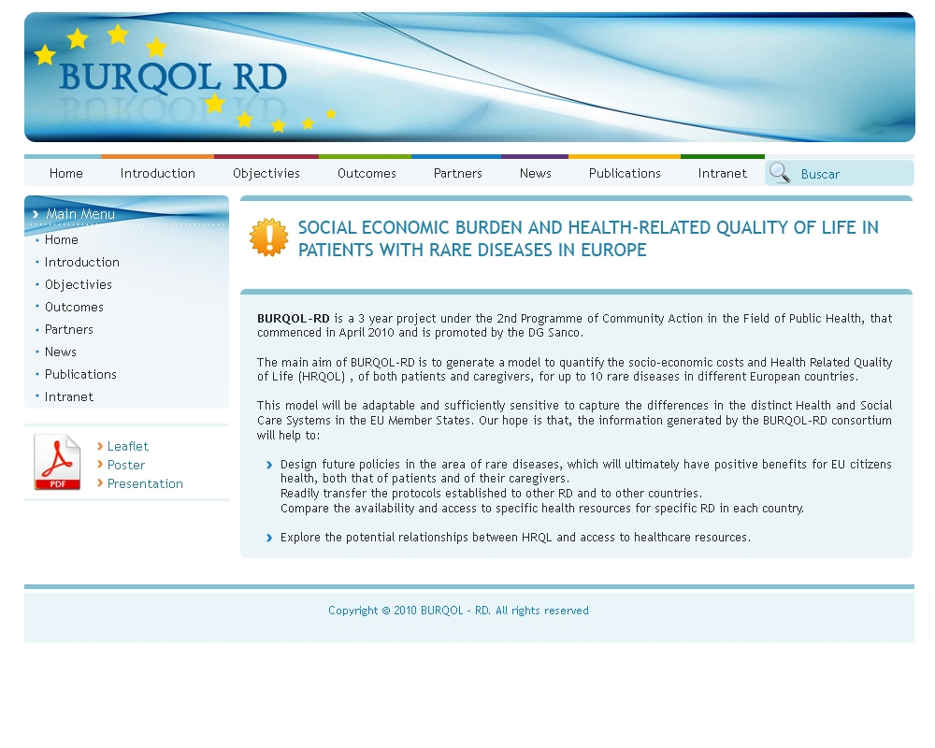
www.burqol-rd.com
www.burqol-rd.com

Slide 19
Thank you for your attention!
Prof. Julio López Bastida
julio.lopezbastida@sescs.es
Renata Linertová
renata.linertova@sescs.es

